Slide 1
Object detection and IMAGE SEGMENTATION

Slide 2
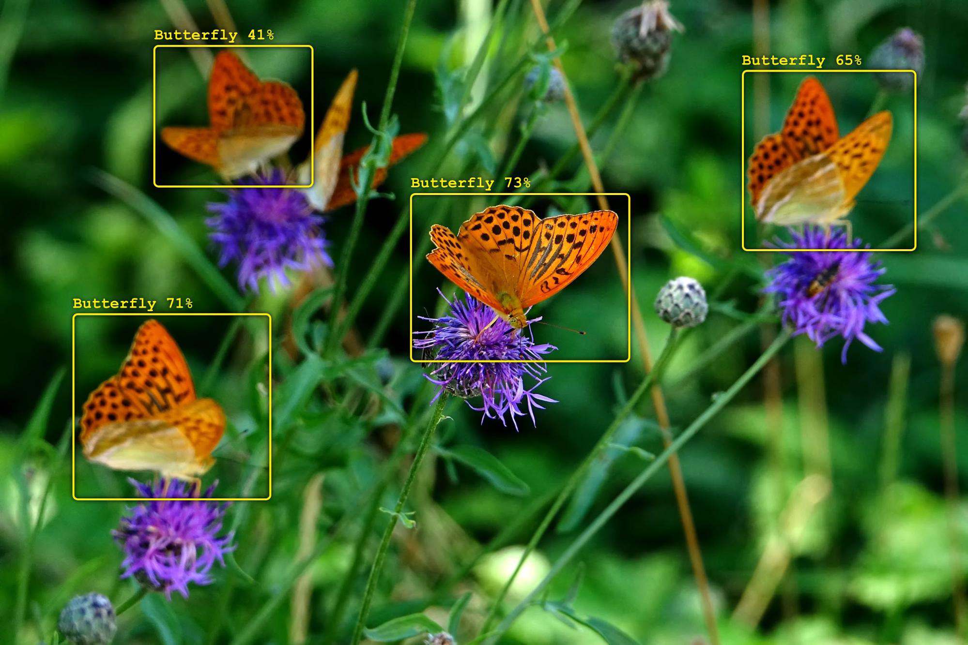
Object Detection
https://www.oreilly.com/library/view/practical-machine-learning/9781098102357/ch04.html

Slide 4
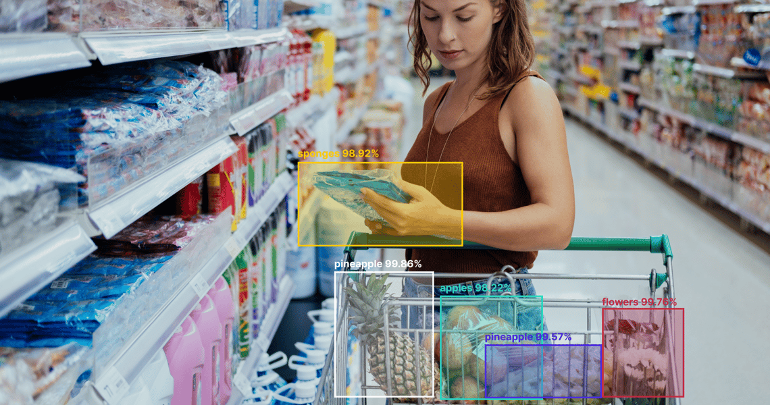

CASE STUDY

Slide 6
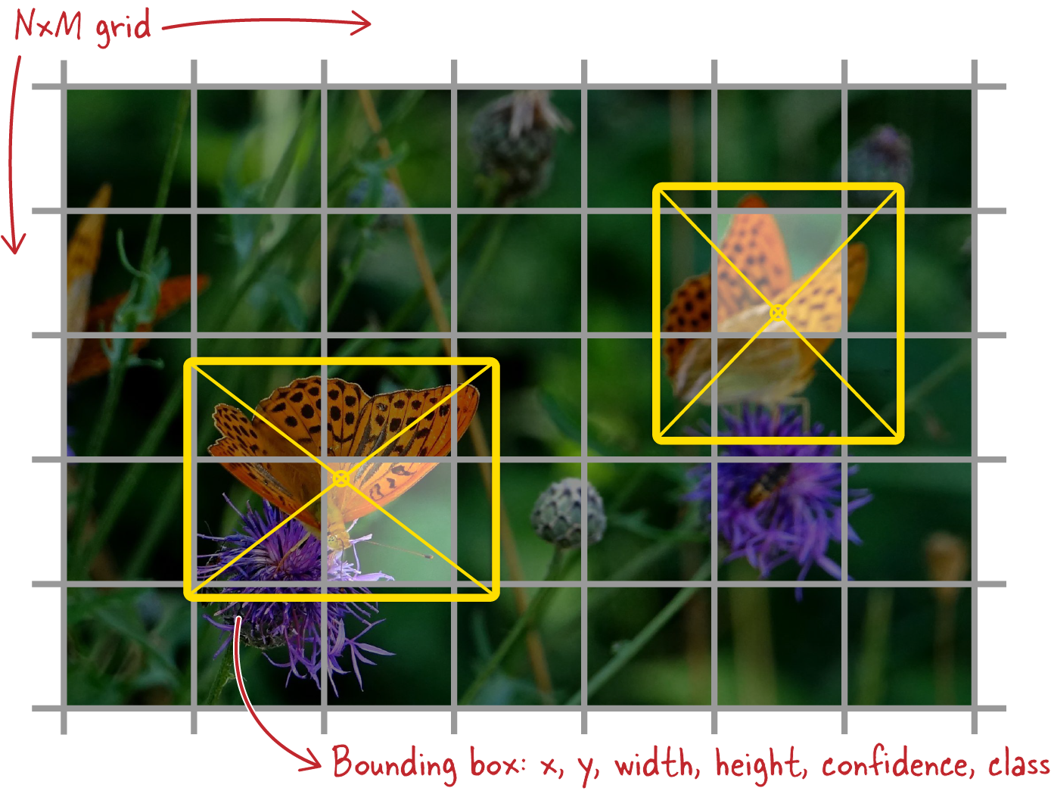
YOLO
https://www.oreilly.com/library/view/practical-machine-learning/9781098102357/ch04.html

Slide 8
Mask R-CNN
https://www.cs.toronto.edu/~fidler/teaching/2018/slides/CSC2548/MaskRCNN.pdf

Slide 10
Semantic vs Instance Segmentation
https://arxiv.org/pdf/1405.0312.pdf

Slide 12
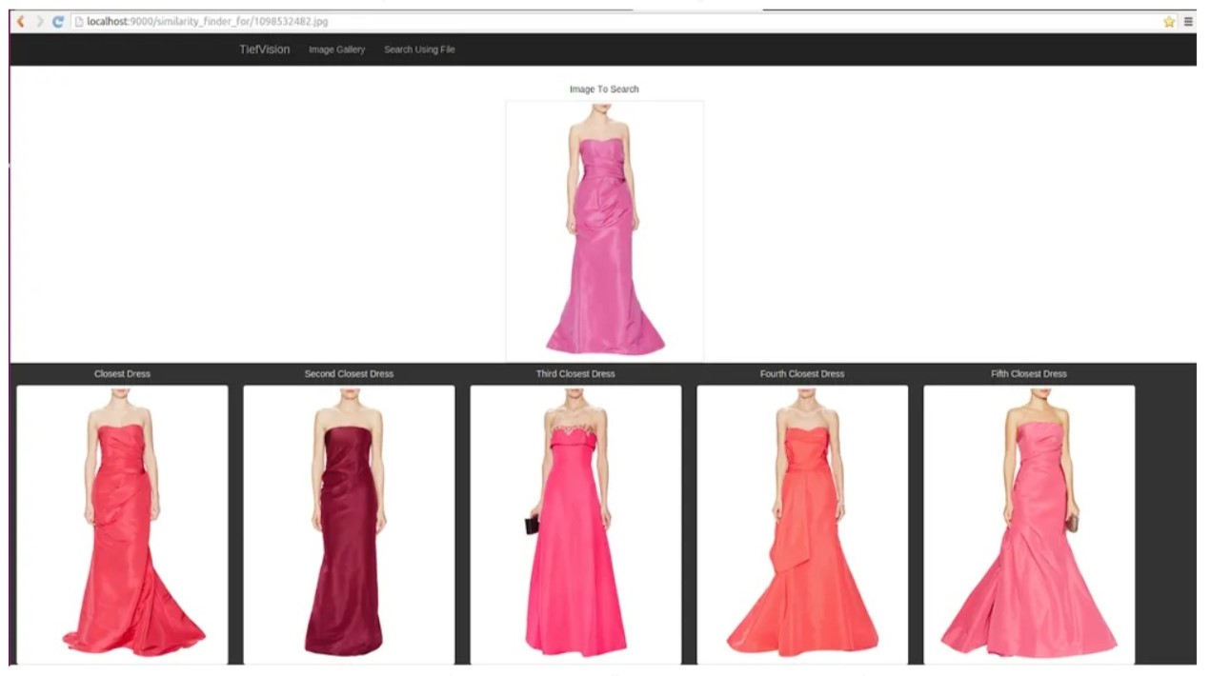
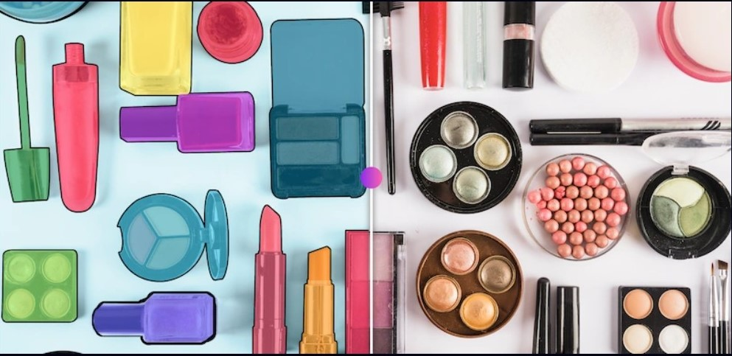
CASE STUDY

Slide 14
Mask r-cnn vs. DEEpLAB

Slide 15
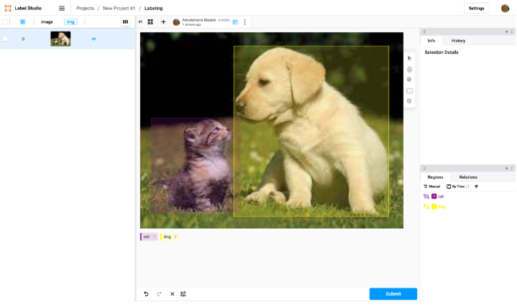
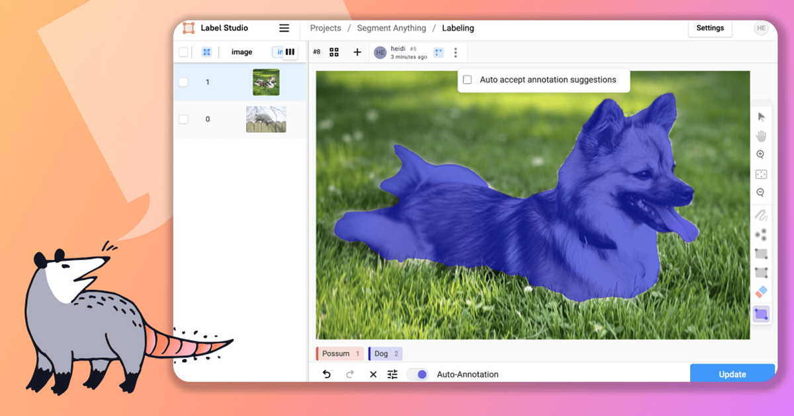
Automate labelling

